Slide 1
X-Band radio telescope
Specifications:
- Low cost: ~3000 CHF, including Notebook and Tripod
Frequency range: 10610 MHz … 11245 MHz
Integration time: 1 ms
Radiometric band width: 300 KHz
Time resolution of spectrum: 500 ms, 250 ms possible
Weight: ~22 kg
Azimuth range: +/- 77°
Elevation range: +/- 77°
Speed: ~2° / sec, depending on temperature and voltage
Output 1: FIT-files à 15 minute with 200 frequency channels
Output 2: Light-curve with 10 pre-selected frequencies, see slide 2

Slide 2
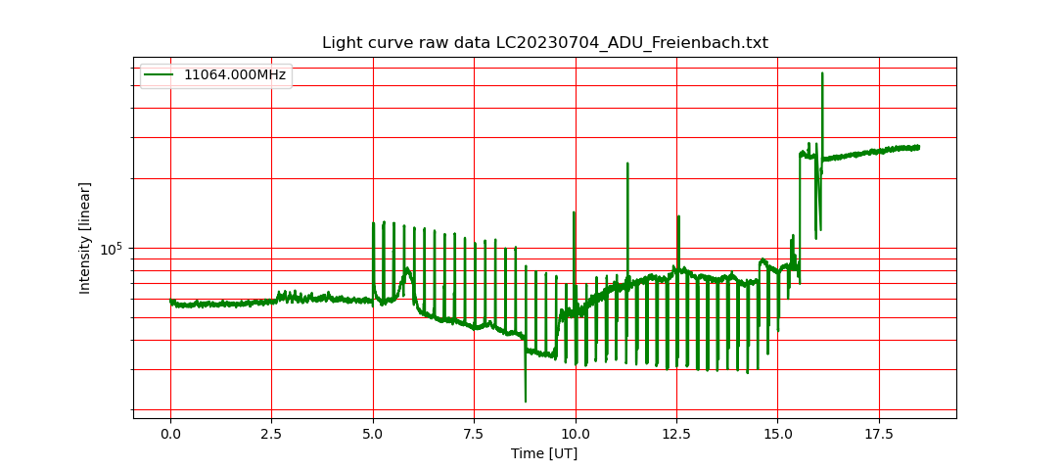
X-Band radio telescope
Daily light curve 1 out of 200 channels in 10610 MHz … 11245 MHz

Slide 3
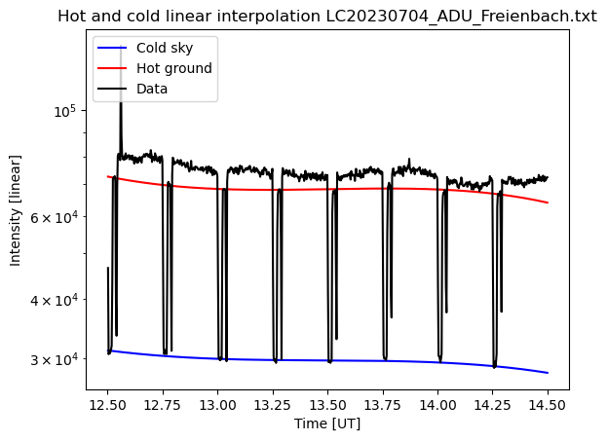
X-Band radio telescope
Interpolation by polynominal cold sky (blue) and hot ground (red)

Slide 4
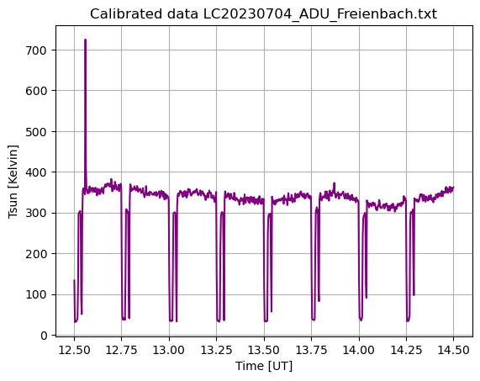
X-Band radio telescope
Conversion arbitrary intensity (digit) into antenna temperature in Kelvin
Tant = (Thot – Tcold)/(Ihot – Icold)* (Isun – Icold) + Tcold
Thot = ambient temeprature [K]
Tcold = cold sky ~12 K … 35 K

Slide 5
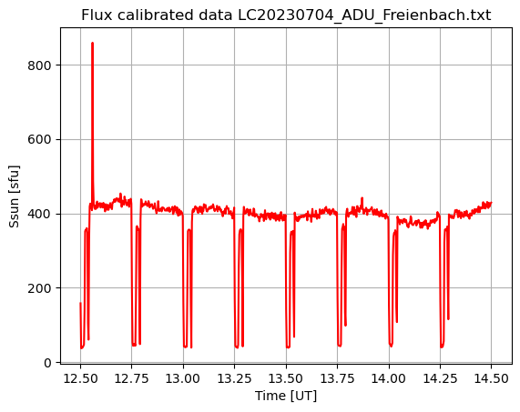
X-Band radio telescope
Conversion antenna temperature into solar flux units SFU
S = (8 π k * Tant) / (λ^2 * Gain) * 1E22
λ = c/f
Gain = ~36 dB = 3981

Slide 6
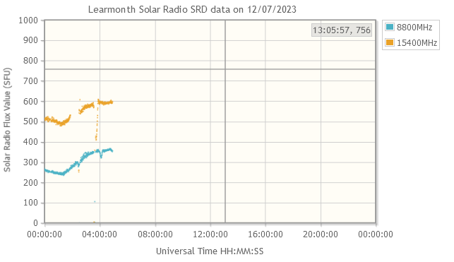
X-Band radio telescope
Cross calibration with Learmonth observations at: https://www.sws.bom.gov.au/World_Data_Centre/1/10
Interpolation between 8.8 GHz and 15.4 GHz
Use peak values around meridian transit

Slide 7
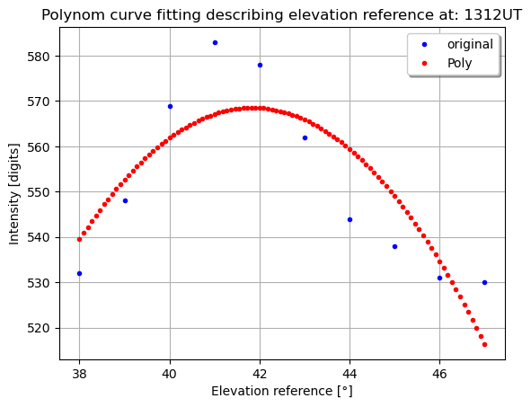
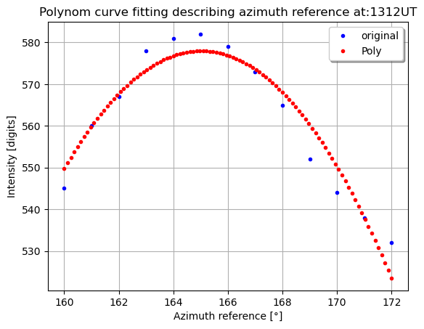
X-Band radio telescope
Problem: Telescope suffers from tilt and squint. -> Measure deviation from optimal position in azimuth and elevation
Every hour during a day of commissioning ~7 observations during summer.

Slide 8
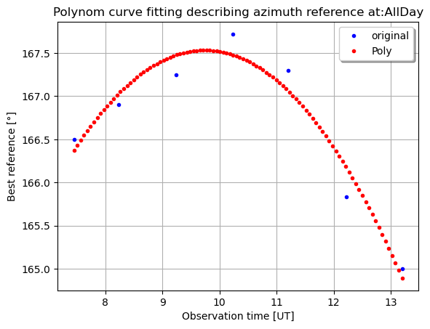
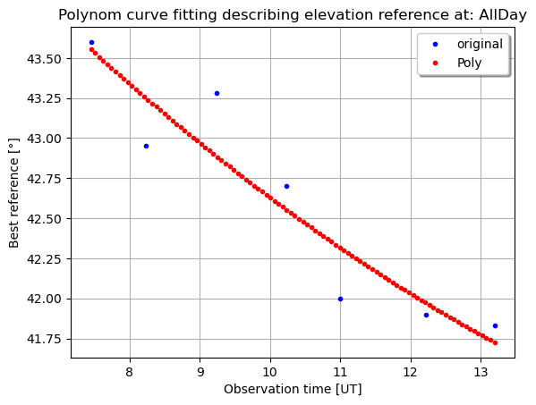
X-Band radio telescope
Solution: Generate two polynomial, one for azimuth offset and one for elevation offset and put it into sun tracker script (Python).

Slide 9
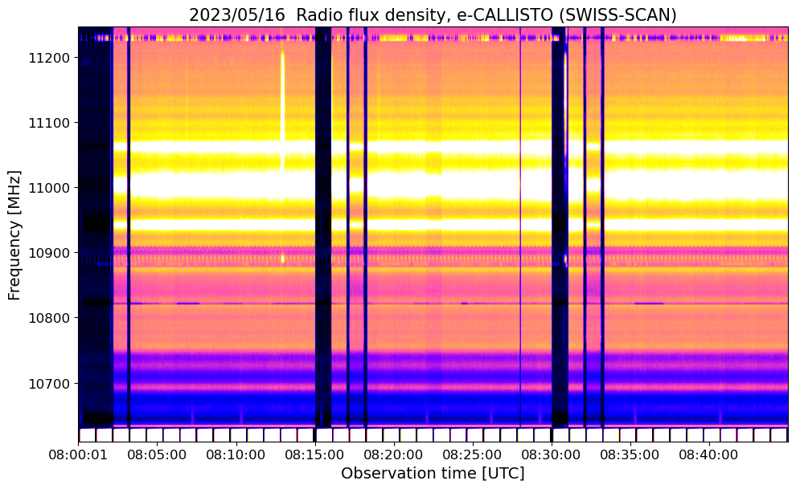
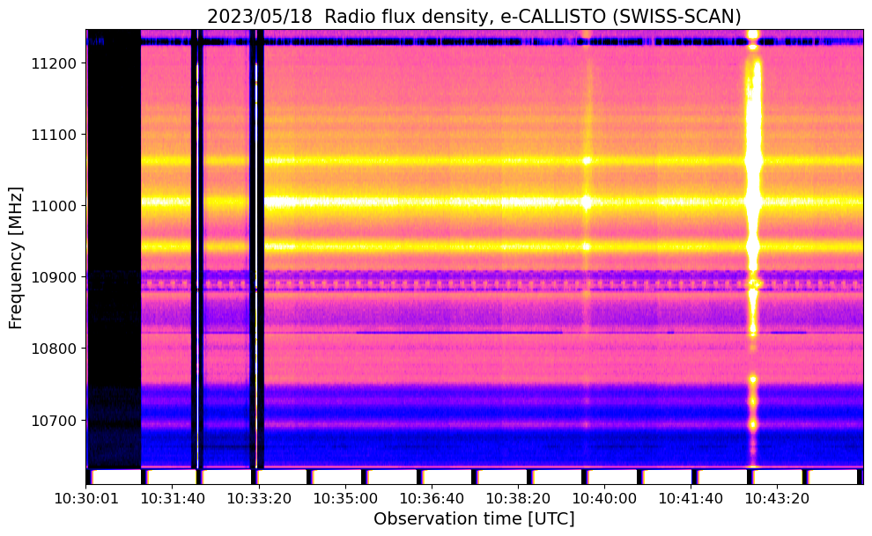
X-Band radio telescope
2D-spectrum with calibrations steps (hot/cold), Starlink satellite and solar radio burst
Calibrations steps+ Starlink
Calibration step + solar radio burst

Slide 10
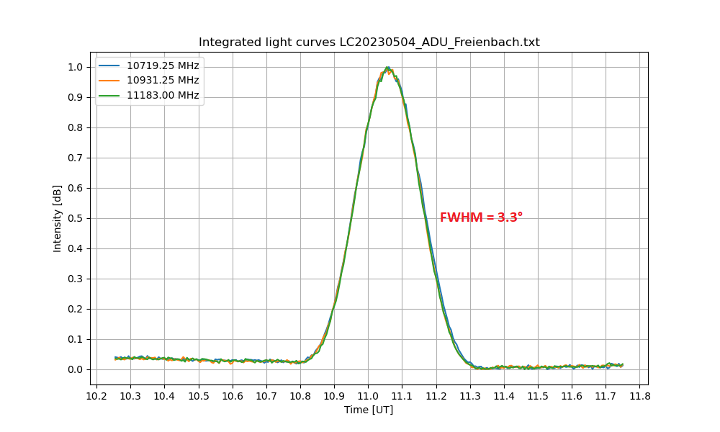
X-Band radio telescope
Beam pattern of satellite dish + wide band LNB

Slide 11
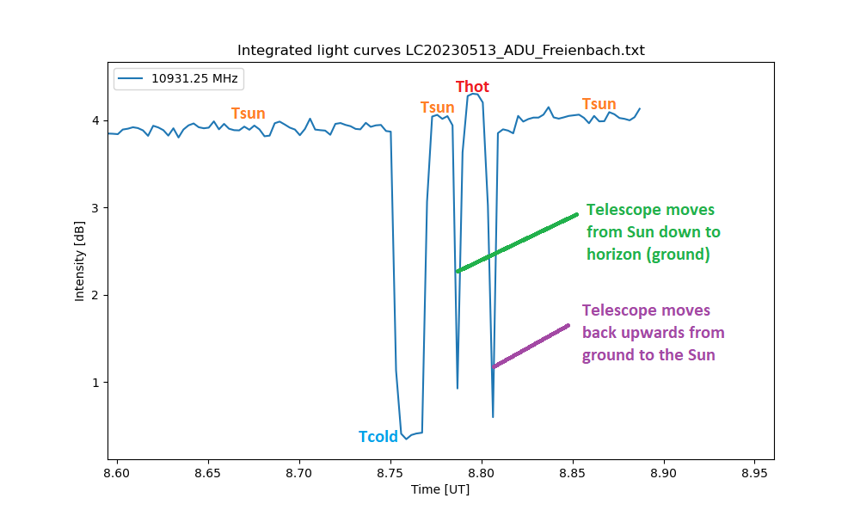
X-Band radio telescope
Calibration steps: Tcold, Tsun, Thot

Slide 12
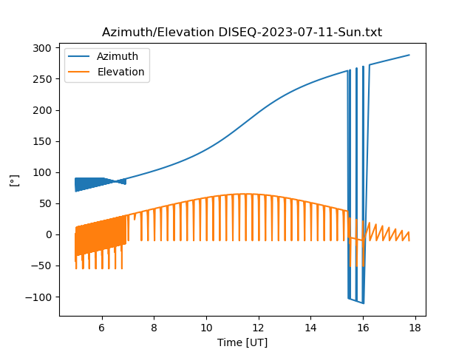
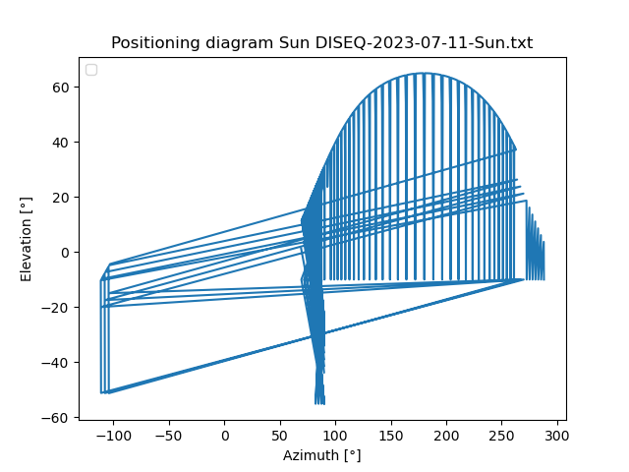
X-Band radio telescope
Plots of tracking system logfile

